Slide 1
Let’s talk hearing!
How we are educating on, treating and researching hearing loss

Slide 2
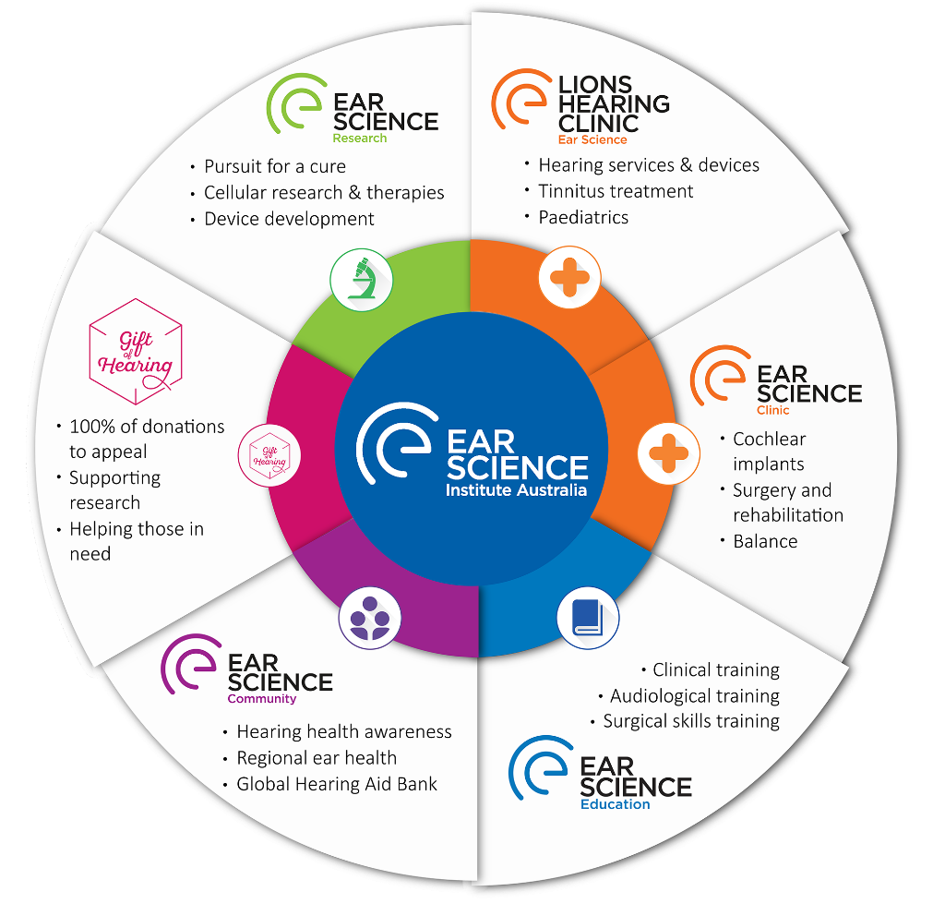
Ear Science Institute Australia
A not-for-profit organisation, providing ear and hearing health care, education and research.

Slide 3
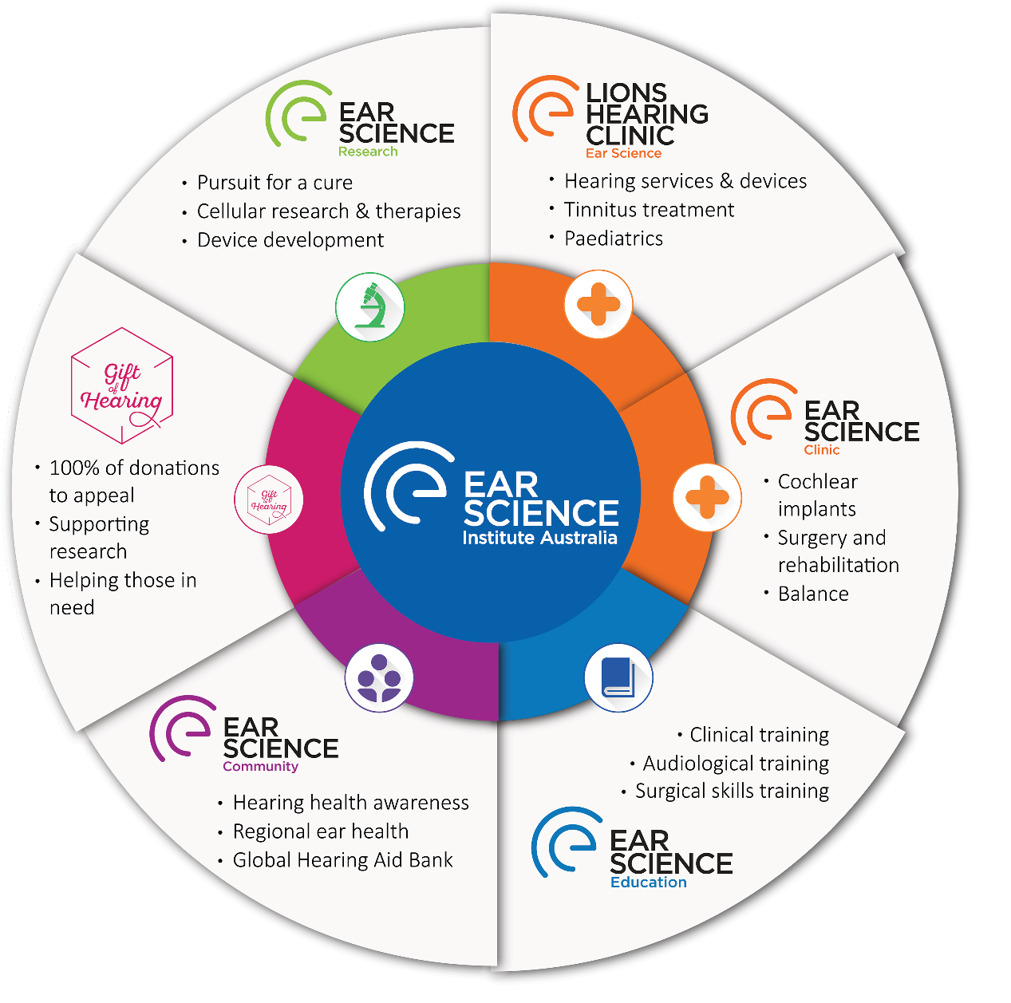
The future of hearing is right here in Perth
Ear Science Institute Australia
Vision: A centre of excellence, enhancing the lives of people with ear and hearing disorders.
Lions Hearing Clinic
Purpose: to improve peoples quality of life through improved communication
Notes:
The future of hearing is right here in Perth
Speak out how cutting edge our research is
Speak about the wheel and the structure of the institute
Gift of hearing fundraised $1.7million, overall research
Translational research focus
Education

Slide 4
Ear Science Institute Australia
14 clinics and 15,000 patients per year
3rd largest cochlear implant centre in Australia
Over 350 articles published since 2001
Clinical trials for ClearDrum®
Scientific collaborations with every continent
World Health Organisation Collaborating Centre – 1 of 6 globally
Training for all medical students
Notes:
Some of our achievements and some of the things going on in your own backyard
14 clinics providing hearing services to 15,000 people per year
3rd largest cochlear implant centre in Australia
Over 360 articles published since 2001
Clinical trials for ClearDrum® - medical device for ear drum repair surgery – received a $4million Wellcome Trust grant to fund human clinical trials and bring cleardrum to market.
Scientific collaborations with every continent, across 15 countries
World Health Organisation Collaborating Centre – 1 of 6 globally; others are 3 in China, 1 Indonesia, 1 Russia.
Since 2019 we've been recognised by the WHO as worlds 6th collaborating centre for ear and hearing care
Training for all medical students attending Western Australian univerisities

Slide 5
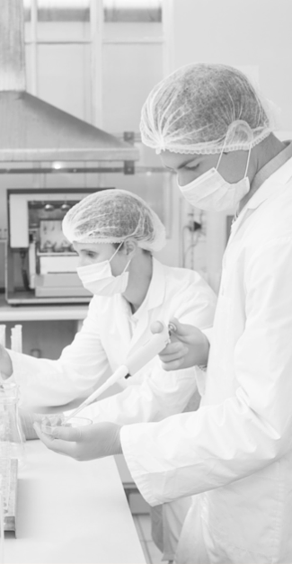
Basic Research
Every year, more than 330 million people suffer from burst eardrums
In a world first trial we are edging closer to helping these people with ClearDrum®
Made with biocompatible silk, ClearDrum® is expected to be less expensive, less invasive and promises quicker healing of the eardrum than current surgical procedures used to treat chronic perforated eardrums
Notes:
ESIA is focussed on translational research that delivers real outcomes for patients.
Our basic research is working on a cellular level in our lab in Nedlands

Slide 6
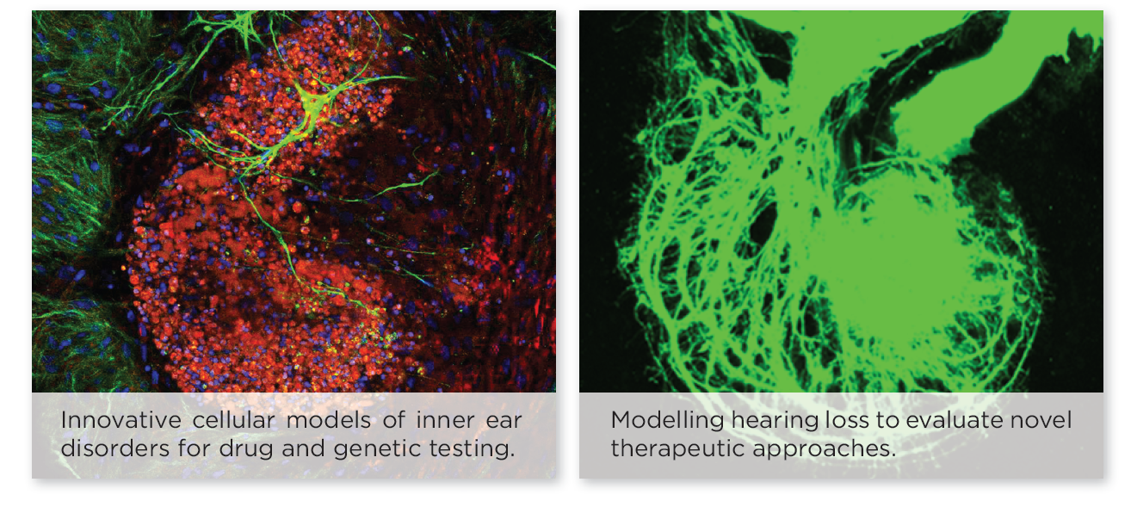
Basic Research
Notes:
Organoid cultures have been developed using human stem cells to model disease and study ways of improving hair cell and nerve cell repair and regeneration.
An example of this is our research is our work with inner ear stem cells, identifying mutations associated with hearing loss in Usher syndrome, Usher Syndrome is an incurable genetic disorder causing hearing loss and visual impairment responsible for over 50% of deafblind people in the world. However, research suggests new treatment of gene therapy or cell therapies may offer a cure

Slide 7
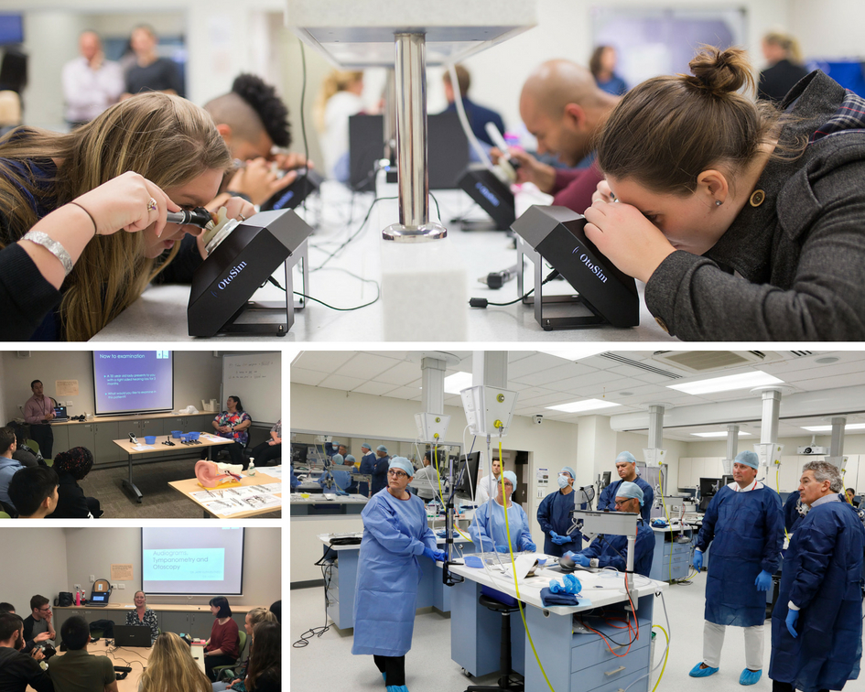
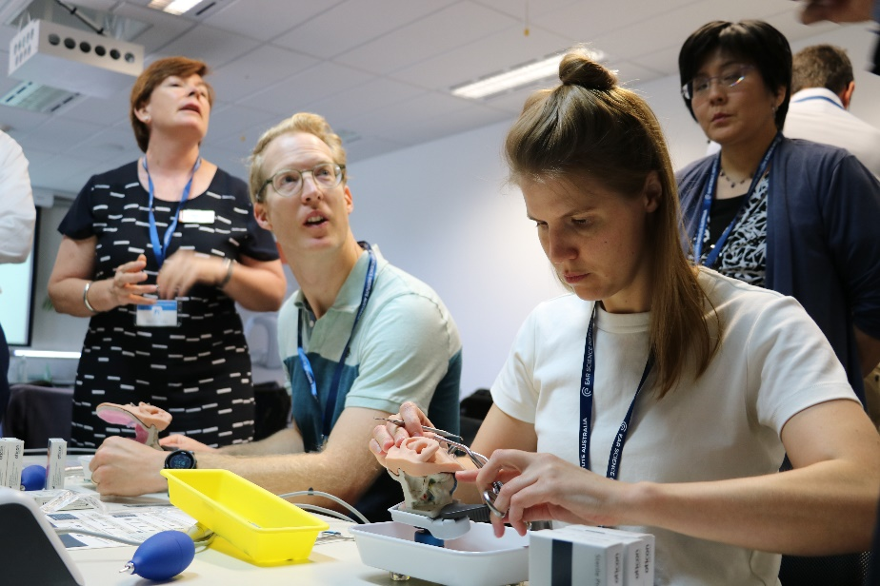
Education
Education and training of all medical students from Notre Dame and Curtin University.
International advanced surgical training courses with our world-class surgeons in our own surgical laboratory.
ion and training of all medical students from UWA and Notre Dame, with Curtin joining in 2019. International advanced surgical training courses with our world-class surgeons in our own surgical laboratory.
Notes:
ESIA is involved in the training of all Future doctors from WA! Inspiring them to become ENTs and to care about hearing and commincation
We also run training courses and upskilling for ENTs and surgeons

Slide 8
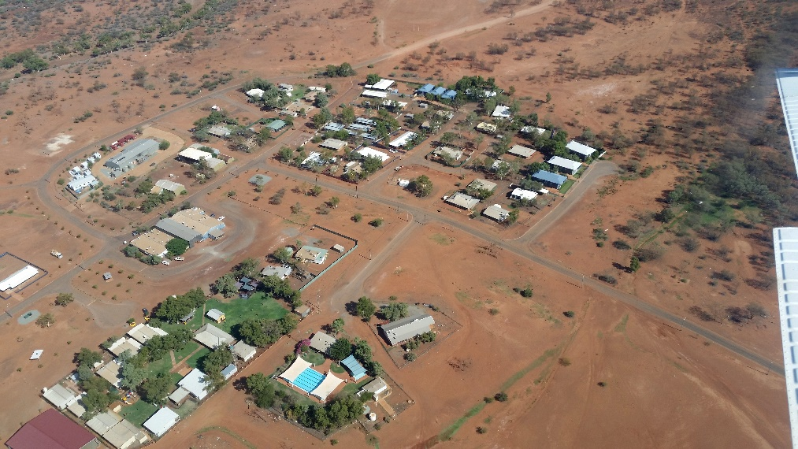
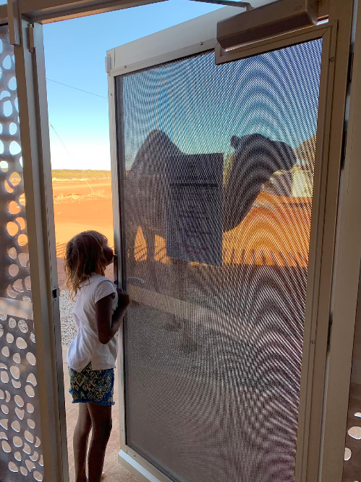
Remote Communities
6 trips per year to 3 remote communities in the Pilbara since 2014
Treating the community & educating on the importance of ear and hearing health

Slide 9
Lions Hearing Clinic
Lions Hearing Clinic
Adult hearing assessments
Hearing aids and beyond
Tinnitus services
Paediatric Services
Ear Science Clinic
Cochlear Implants
Balance services
All hearing implants
Notes:
The Lions Hearing Clinics and Ear Science Clinic are important arms of ESIA
Being part of the institute allows our clinical processes to be up to date and cutting edge which allows us to provide our patients with the best care
(This is where I generally talk about my clinical history and myself)

Slide 10
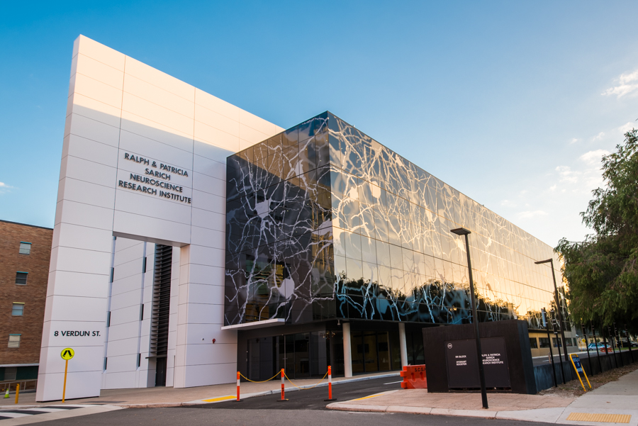
Benefits of Lions
Client centred care
Part of a not-for-profit organisation
Profits are directed into research and community services
All clinical processes are evidence based
Clinicians provide a needs based service that is not subject to commissions
Provide hearing aids from a wide variety of manufacturers
Notes:
Lions Hearing clinic values client centred care and we’re proud to be part of a not for profit organisation
As I said before one of the major benefits of working for, or seeing, the Lions Hearing Clinics or Ear Science Clinic is that all of our processes are evidence based and driven by research - because we are a research institute at heart. Because of this, you will find that none of our clinicans have any kind of commissions are we are not own by a hearing aid manfucturer – giving our clinicans the freedom to make recommendations that will best suit you

Slide 11
Let’s talk hearing
How common is it and why should I address it?
Identifying hearing loss
Hearing solutions
Notes:
So let’s talk hearing – we’re going to talk about the prevalence of hearing loss and the reasons why your hearing is more important than you might think.
We’ll go over some ways to identify hearing loss- ranging from comprehensive testing in the clinic to simple clues you can look for at home
Finally we will go over some common solutions we use to address a hearing loss.

Slide 12
How common is it?
Notes:
I always, always talk about two things first when I’m telling people to care about their hearing
The prevalence of hearing loss and
The impact that it has on our health and our happiness

Slide 13
1 in 6 Australians are living with hearing loss
Increasing to 50% of Australians over 65, and 70% over 70
(Access Economics, 2006)
Notes:
Globally 466 million people worldwide- WHO.
In Australia 1 in 6, increasing to 50% over 65 and 70% over 70
Hearing loss is highly prevalent in Australia and this increases in older adults.

Slide 14
The impact of hearing loss
Notes:
The main reason we need to care about hearing loss is that impact that it has. Hearing loss is often gradual and difficult for the person experiencing it to notice. It isn’t life threatening, but it has a much greater impact that we first realise

Slide 15
Hearing loss can lead to social withdrawal and isolation
Notes:
Hearing loss is a risk factor for social isolation and loneliness. Social participation has been identified as key to healthy aging.

Slide 16
Wearing hearing aids can reduce the risk of social isolation
Keeping socially active is important to healthy ageing
Notes:
Wearing hearing aids have been shown to have a protective effect and allow greater social participation and engagement in those with hearing loss (Weinstein et al. 2016).
Hearing aid use improves quality of life by reducing the social and emotional effects of hearing loss (Chisolm et al. 2007).

Slide 17
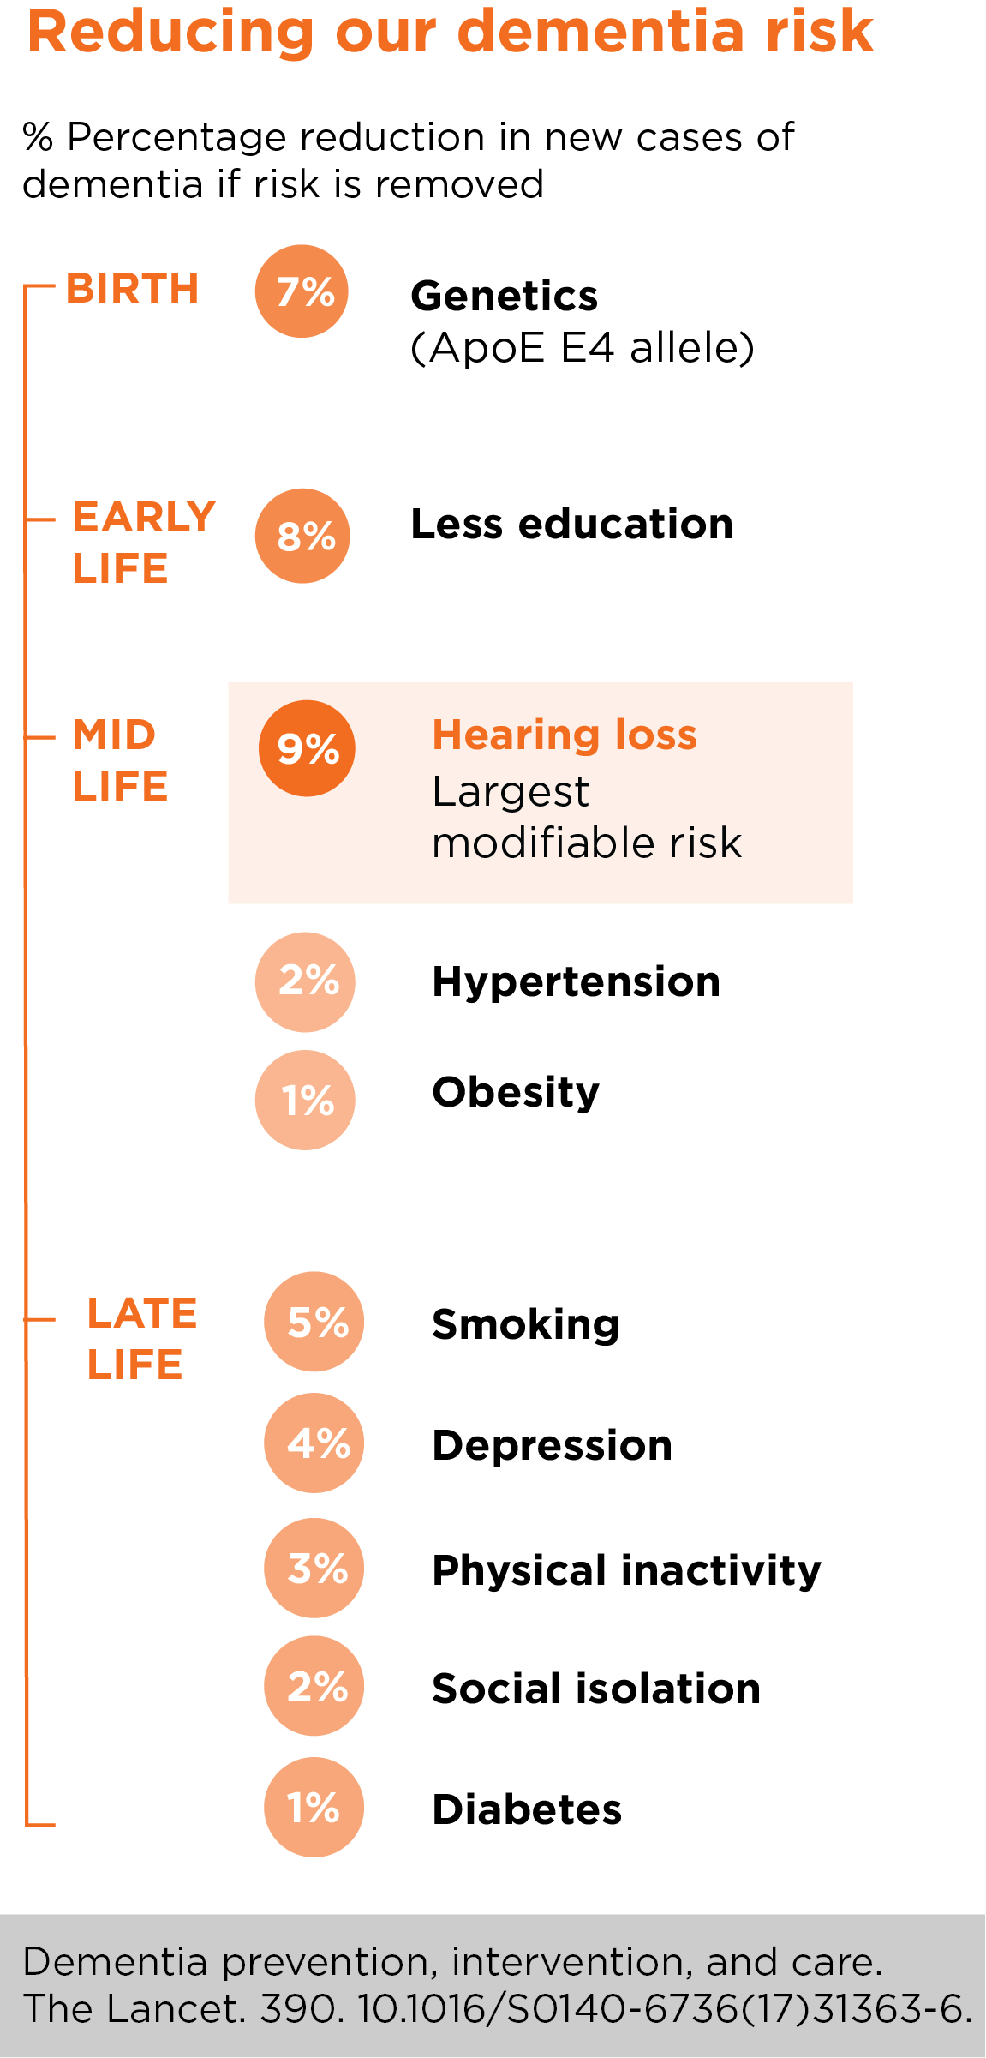
Hearing loss has been identified as a potentially modifiable risk factor for dementia
Notes:
A recent study published in The Lancet reported that 35% of global dementia cases may be preventable. Hearing loss was identified as the largest modifiable midlife risk factor for dementia (Livingston et al. 2017). Hearing aid use in adults with hearing loss is associated with lower rates of cognitive decline (Lin et. Al., 2013).
Hearing and cognition is a huge research interest of the institute at the moment – talk about Dona’s research

Slide 18
Hearing loss has been associated with depression, anxiety and stress in older adults
Notes:
Some of this research has come out of our own institute
(Jayakodya 2018) : Association between speech and high-frequency hearing loss and depression, anxiety and stress in older adults 2018
Other references: , (Cosh et al. 2018) The relationship between hearing loss in older adults anddepression over 12 years: Findings from the Three‐Cityprospective cohort study

Slide 19
Risk of frailty increases by 63% in older adults with hearing loss
Notes:
Hearing loss is also associated with frailty and in this way can affect our physical health
Frailty is group of 3 or more of the following symptoms:
Unintentional weight loss
Self-reported exhaustion
Slow walking speed
Low physical activity
Frailty increases possibility of falls and hospitalisation
Risk of frailty increases by 63% in older adults with hearing loss.

Slide 20
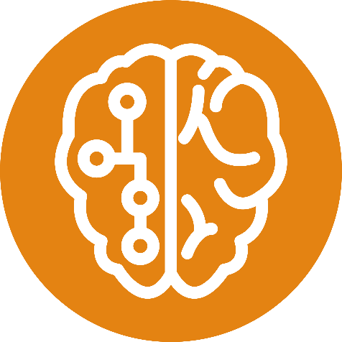
On average it still takes people 7 years to act on their hearing loss
Notes:
Even with 466 million people worldwide with hearing loss, even with the association of hearing loss with various aspects of our health, even with the significant impact that hearing loss has on our mental health, cognitive health and our ability to age healthily---- it still takes people 7 years to act on their hearing loss!
With the Lancet study highlight the impact that addressing hearing loss can have in mid-life– this makes it even more important that we not only close this 7 year gap, but identify and intervene for hearing loss earlier.
We need to reduce this 7 year delay.

Slide 21
Identifying hearing loss
Notes:
We have the best chance at reducing this delay if we can identify hearing loss EARLY. So I want to talk today about signs of hearing loss to be on the look out for and ways to know for sure about the status of your hearing health

Slide 22
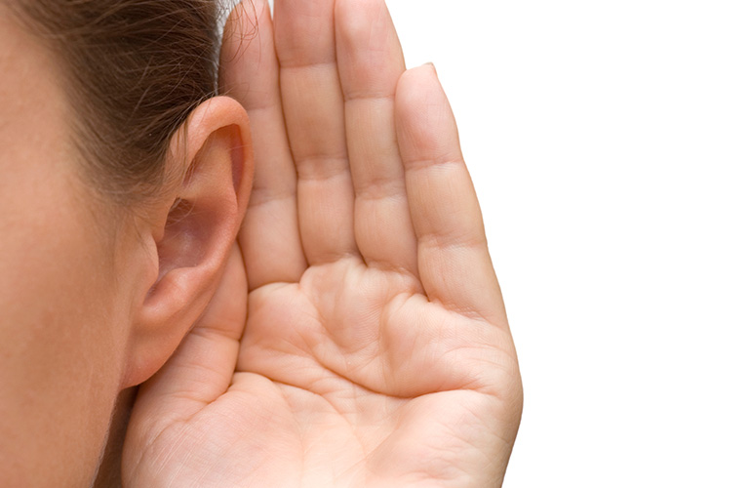
Signs of hearing loss
Constant requests for repeats
Complaints that other people are mumbling
Unexplained lethargy
Reduced social activity and withdrawal
Domination of conversation
Confusion and miscommunication
Unexplained sadness and depression
Needing the TV volume louder than your family
Notes:
The first thing you can do this look out for the signs of hearing loss….

Slide 23
Identifying hearing loss in the clinic
Appointment | Cost
Hearing Screening | FREE for everyone
Adult Hearing Assessment | $100 without Pension/DVA Card FREE with Pension/DVA Card
Note: Pension/DVA card may also be eligible for subsidy on hearing devices
Notes:
If you are noticing any of these signs in yourself…. Or a loved one… these are the ways we can identify a hearing loss in the clinic
You have your hearing screened or assessed.
Both of these are methods of testing hearing
Screening- quick check, can take many forms : questionnaires, machines, hearing bus, in clinic. Says if a hearing loss is present, yes or no. Cannot inform management, free for everyone
Assessment – comprehensive, full picture of hearing, can report results to you and your doctor, can identify if there is any medical treatment needed, can inform management options.

Slide 24
Hearing Solutions

Slide 25
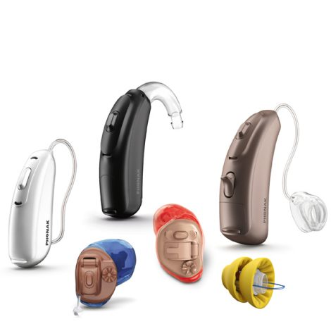
Hearing solutions
Communication strategies
Medically treatable conditions
Antibiotics, steroids, surgery
Assistive listening devices
Hearing devices
Implantable devices
Notes:
While a hearing screening is a great starting step, as we said before a hearing assessment is needed to be able to recommend a solution to a hearing loss.
There are many solutions available and between Lions Hearing Clinic and Ear Science Clinic we can offer them all based on what you NEED

Slide 26
Communication Strategies
Speak Clearly
Limit background noise
Re-phrase
Gestures
Closer & face the person
Notes:
It might be something as simple as communication strategies….. Something everyone can take away from today!

Slide 27
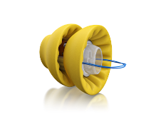
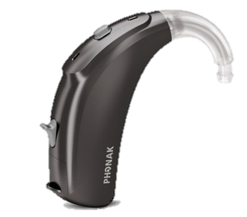
Hearing devices
Lyric
IIT (In the ear)
RIC (Receiver in canal)
BTE (Behind the ear)
IIC (Invisible in the canal)
Notes:
However, if there is a permanent hearing loss present and you are finding difficulty hearing in one or more situations, the most common recommendation is hearing devices. There are many Different styles of hearing aids and when we help you to select the right ones, we take into account things like:
Physical considerations
Lifestyle considerations
Environmental considerations
Asking the questions in the beginning, setting hearing goals and listening to the patient allow us to get the best outcomes with hearing devices.

Slide 28
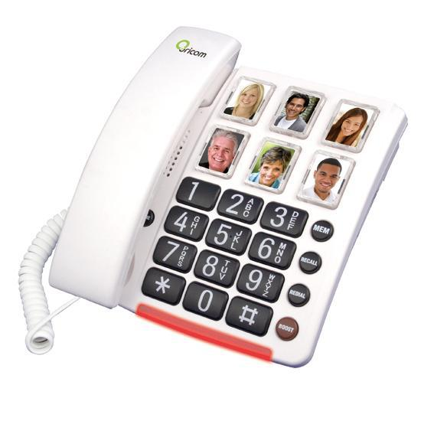
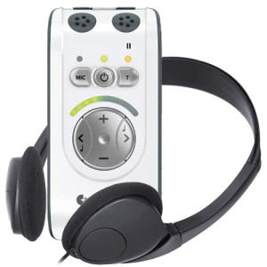
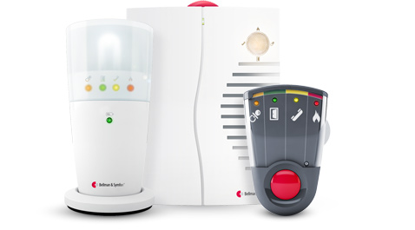
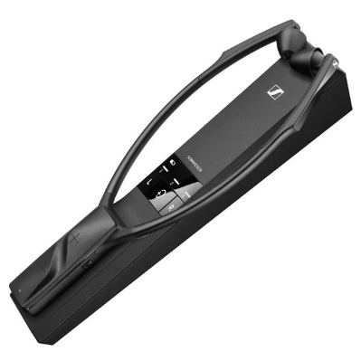
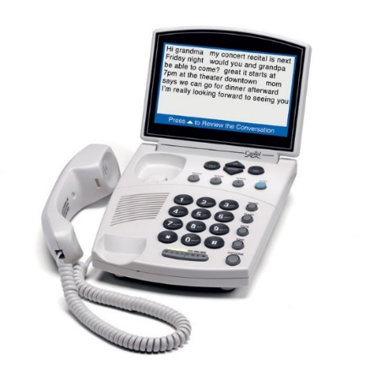
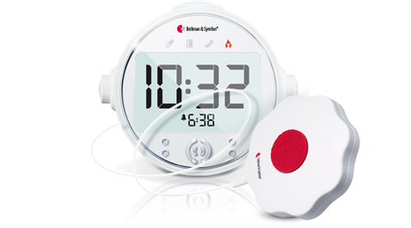
Assistive listening devices
TV | Phone | Personal Sound Amplifier | Alerting Systems
Notes:
For some people, hearing devices may not be something they are ready for or might not even be appropriate for them – we also offer ALDs

Slide 29
What if hearing aids are not enough
There are situations when hearing aids are no longer enough
Hearing continues to progressively deteriorate over time
Hearing aids are well adjusted, but clarity is always an issue
Hearing aids can’t be used because of persistent ear problems (e.g. ear infections)
Notes:
Ear Science Clinic
Implantable solutions – what are they

Slide 30
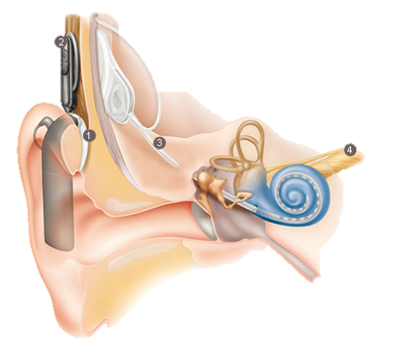
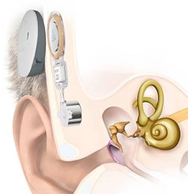
Implantable solutions
Cochlear implants
Bone conduction Implants
Middle ear implants

Slide 31
Take home message: don’t wait 7 years to address your hearing!

Slide 32
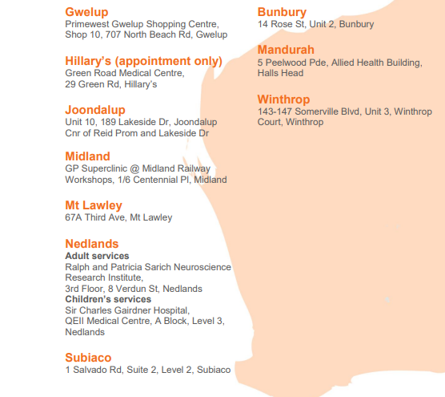
Where we are located?
Notes:
You can also see us at……..

Slide 33
Thankyou for listening!

